Slide 1
Restaurant Sales

Slide 2
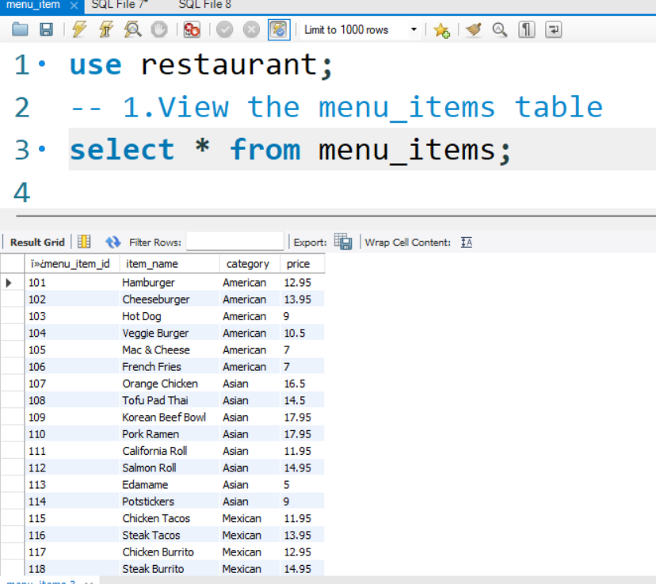
Menu Details

Slide 3


Slide 4


Slide 5


Slide 6
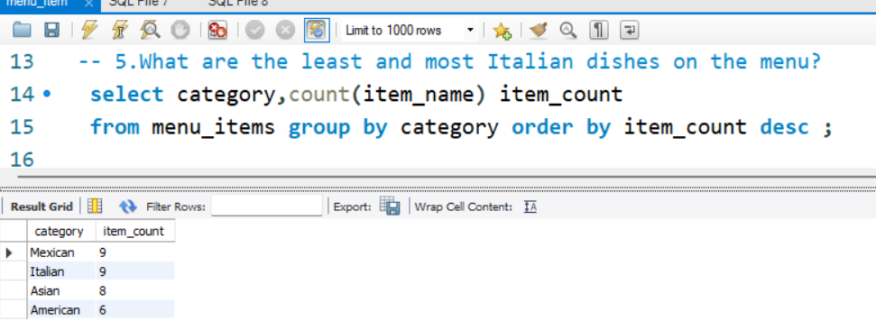

Slide 7
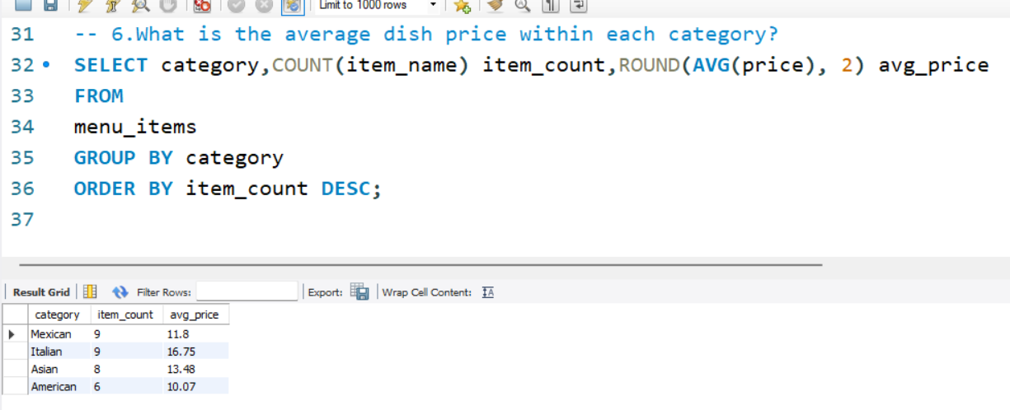

Slide 8
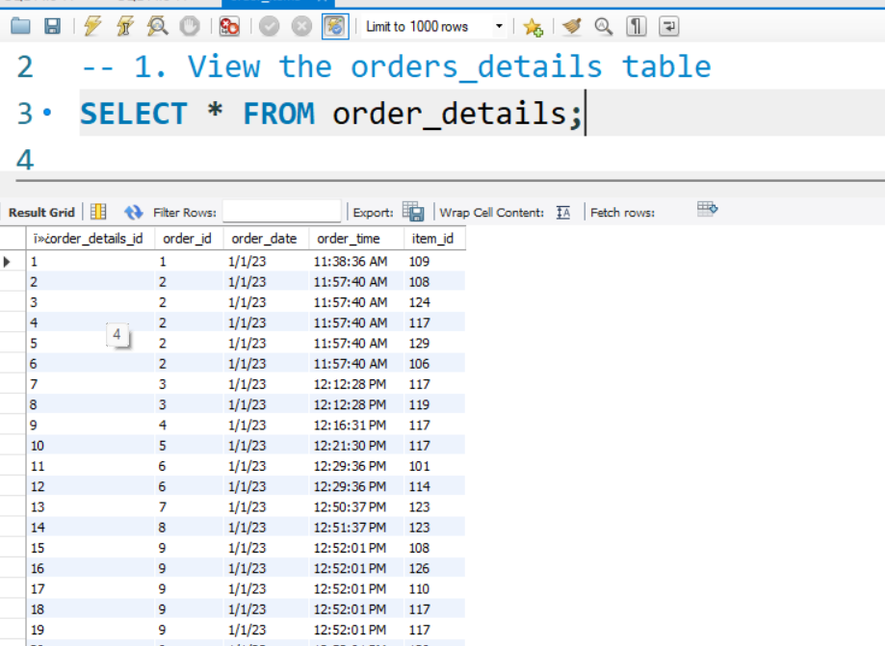
Order Details

Slide 9


Slide 10


Slide 11


Slide 12
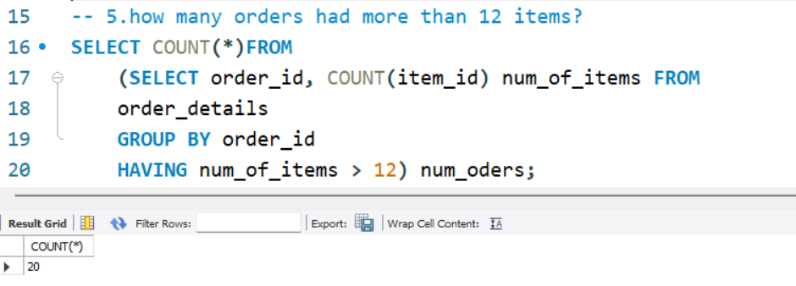

Slide 13

JOINS

Slide 14
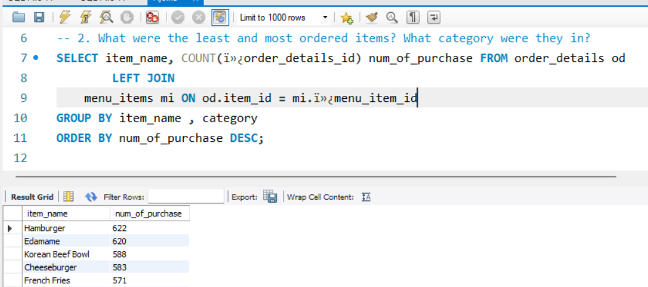

Slide 15
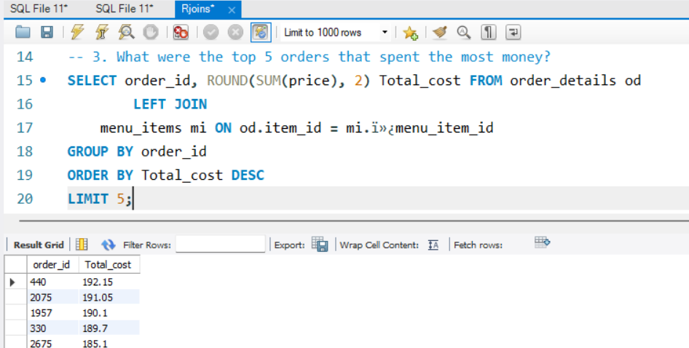

Slide 16
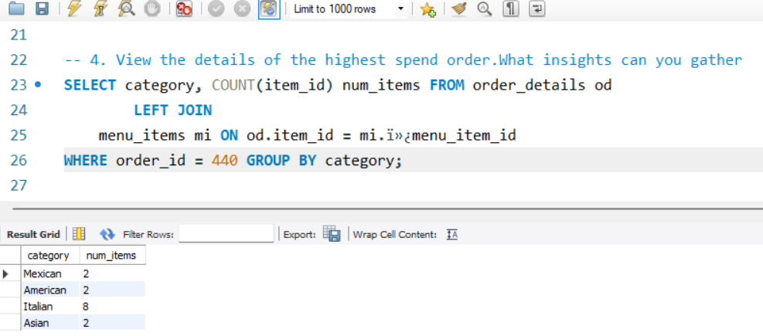

Slide 17
